Slide 1


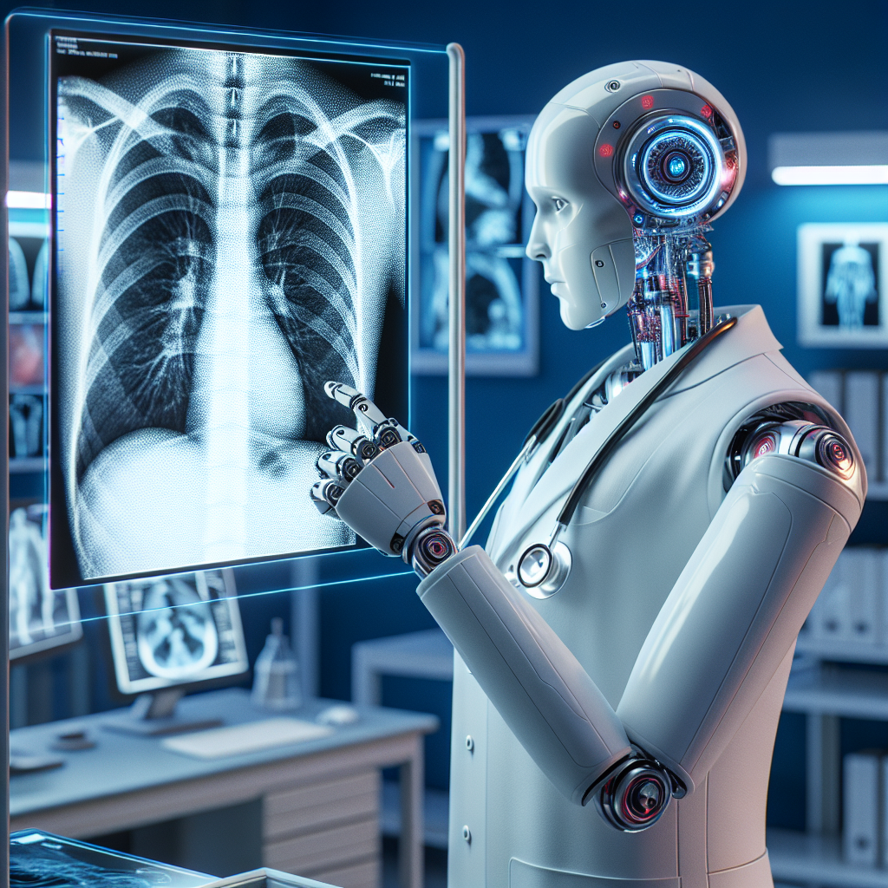
Chest Check

Slide 2
Represented by:
Ali Arabi Ali
Rodan Mohamed
Yara Fatouh
Under supervision
DR.Esraa Ahmed

Slide 3
Overview​
My story
Problems
Artificial Intelligence​
Classifica﻿tion​
Fea﻿tu﻿re​
Solutions​
Goals​
Steps to ﻿create the model
Image enhancement​
Information about the Ai mod﻿el​
Results​

Slide 4

How can we save human lives through artificial intelligence?

Slide 5

My story
Abu El maaty
This is my grandfather
The best person in my life

Slide 6
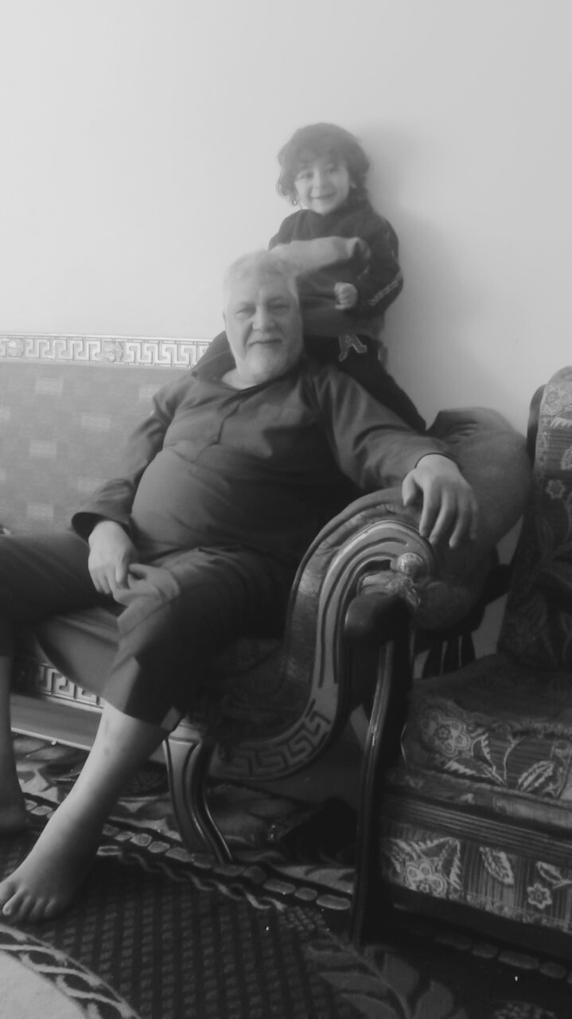
My story
Abu El maaty
This is my grandfather
The best person in my life

Slide 7
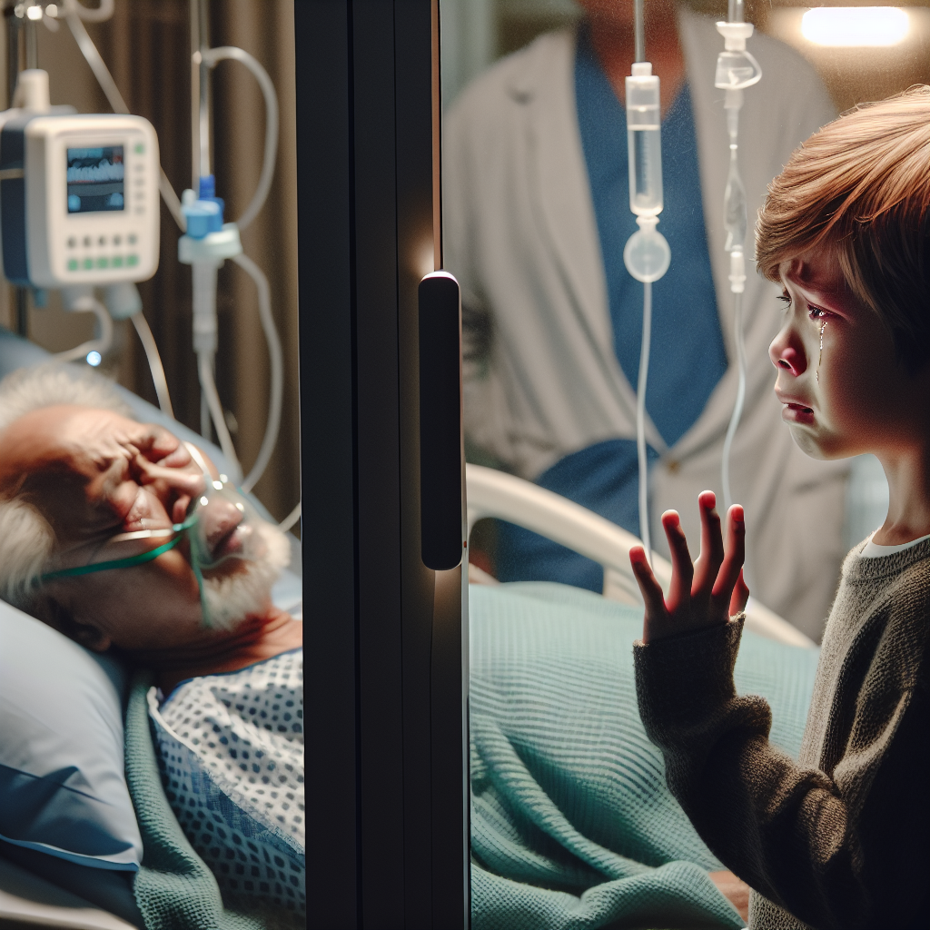
My story
Feeling of helplessness
My grandfather died on
2018/3/3

Slide 8

Problem
The main problem was not pneumonia
Doctor Human error
Work for more than 12 hours
Lack of concentration

Slide 9
Problem
This is the year 2018
This is the year 2018
From 2021 to 2024

Slide 10
Artificial Intelligence

Slide 11

Artificial Intelligence
Artificial intelligence is not magic
AI is a set of mathematical equations

Slide 12
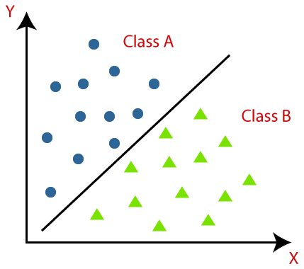
Classification
classification is a process where AI systems are trained to categorize data into predefined classes or labels.

Slide 13
How classification works

Slide 14
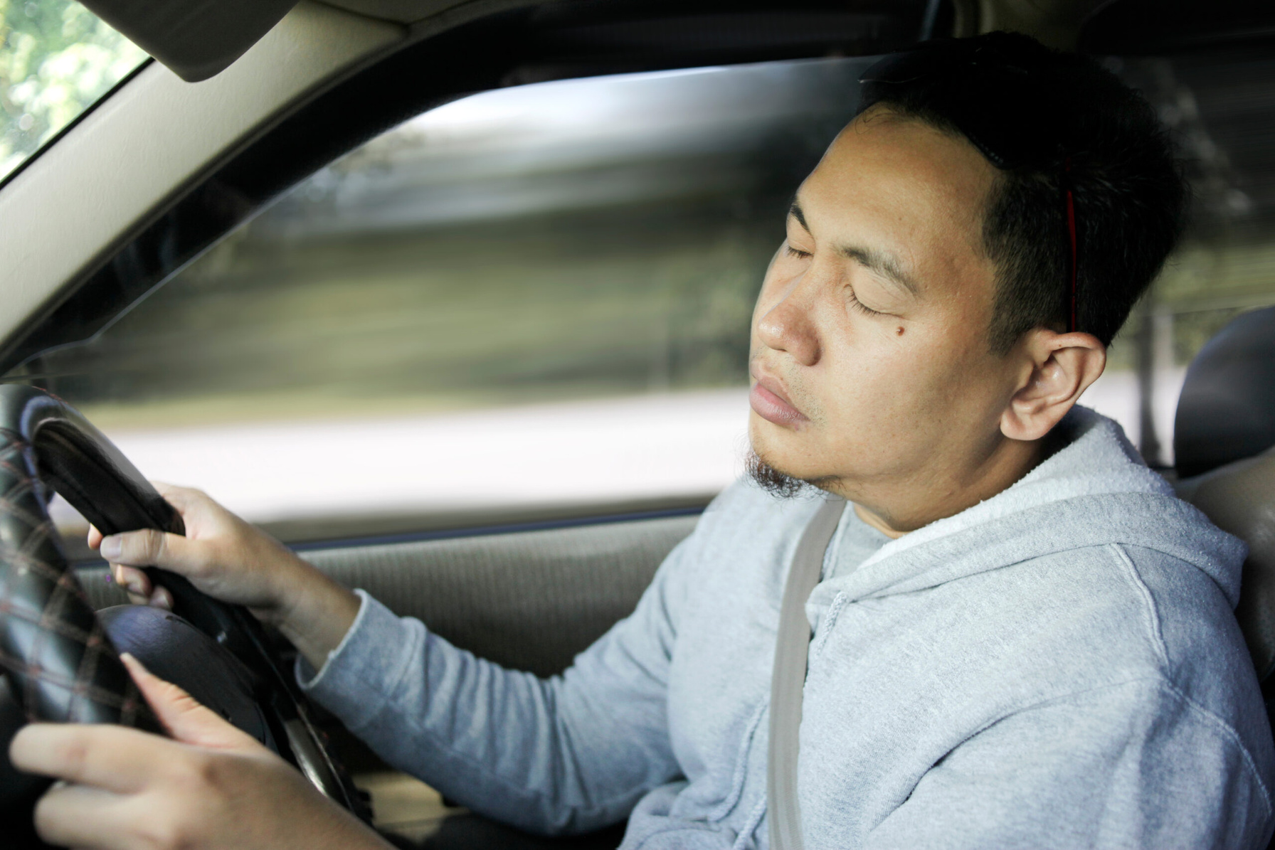

Featu﻿re
Classification works across featu﻿re
Feature is a characteristic used by the model to determine the class of data.

Slide 15
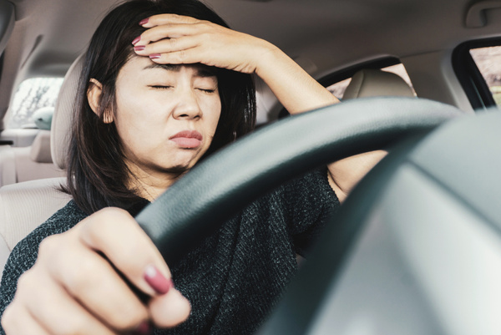

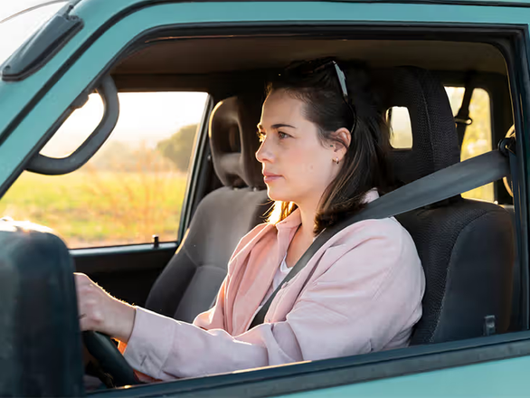
Featu﻿re
Cl﻿ass 1
Cla﻿ss 2

Slide 16
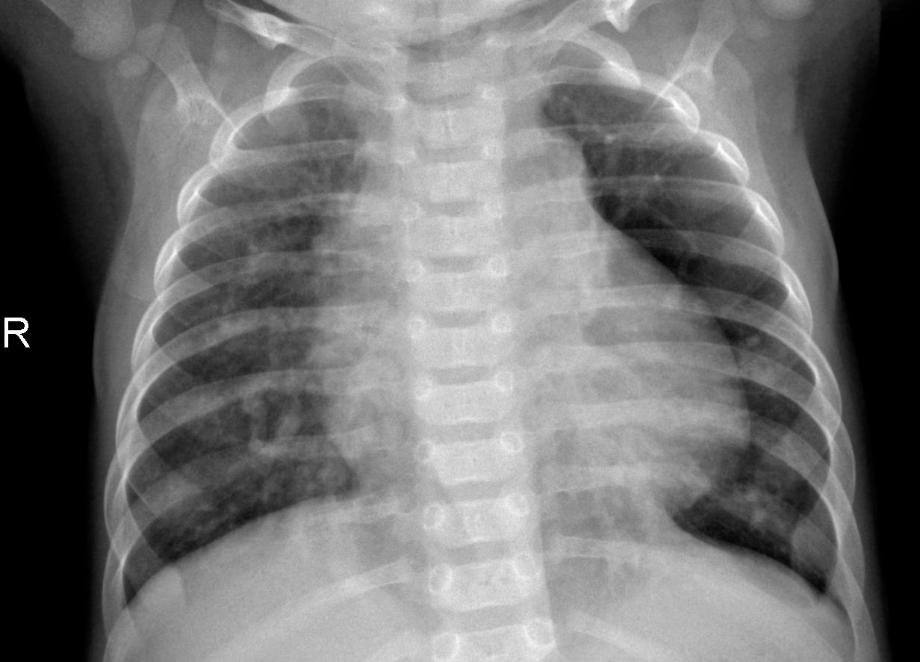
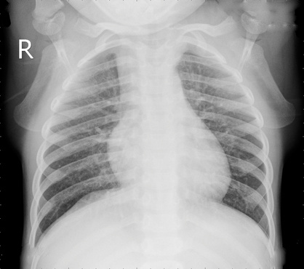
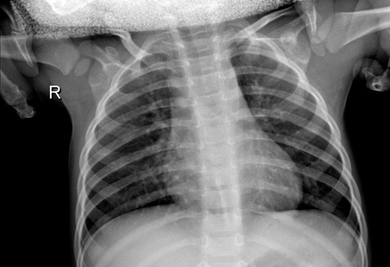
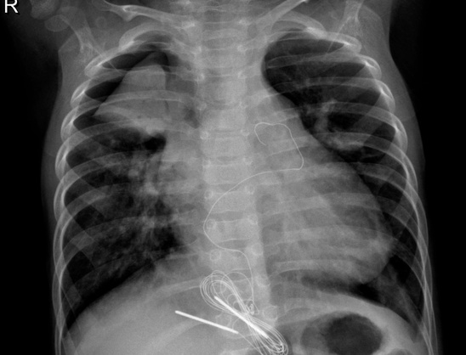
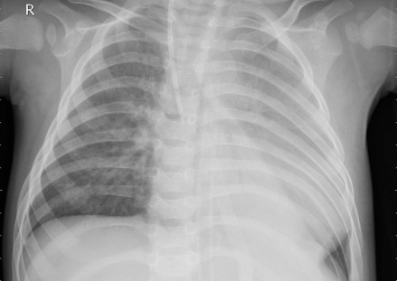
Featu﻿re
Norm﻿anl Cl﻿ass
Pneumo﻿n﻿﻿ia Cla﻿ss

Slide 17
Solution
We decided to create a simple detection website powered by an AI model
The chest X-ray image entered by the user has pneumonia Illness or not

Slide 18
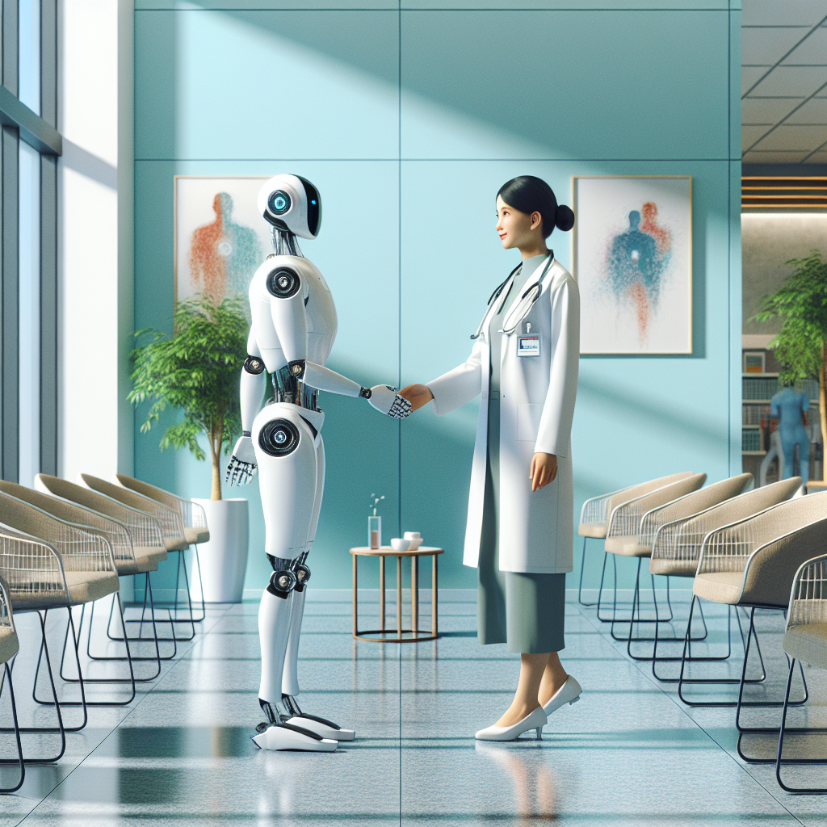
Goals
We are not trying to replace the doctor
We are trying to use the capabilities of AI
In saving human lives
protect them from any human error

Slide 19
Steps to create the model

Slide 20

Steps to create the model
Data Collection
Data Enhancement
6
Data Splitting
4
Sellect algorithom CNN
6
Data Testing
5
Data Taranning
7
Model Optimization

Slide 21
Enhancement

Slide 22
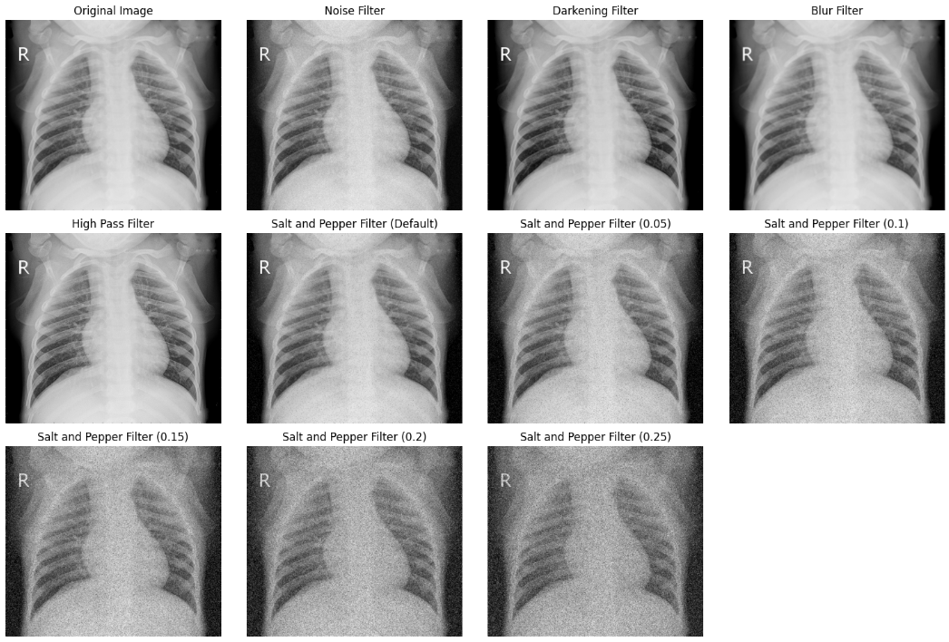
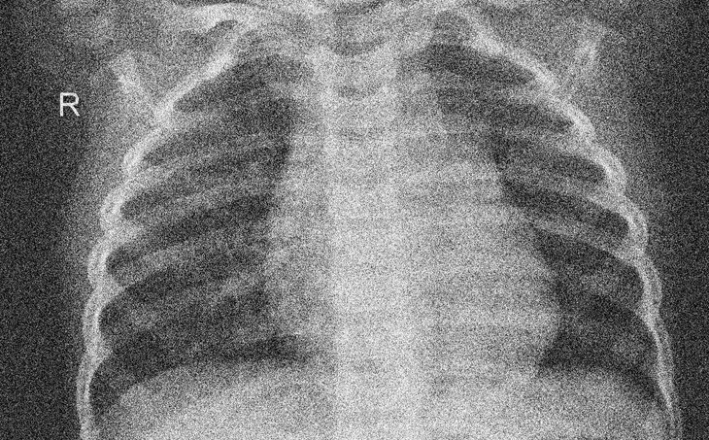
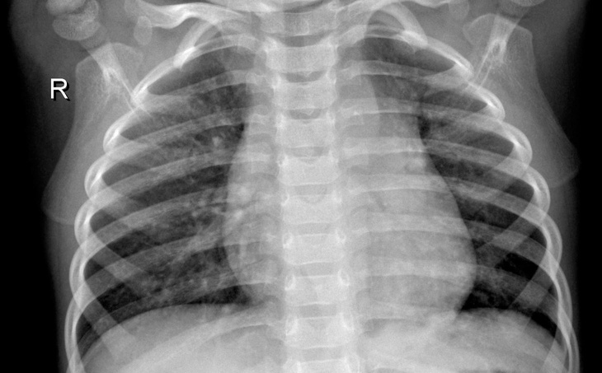
Noise removal
Orignal image
Image after filter
The first stage
Noise removal

Slide 23
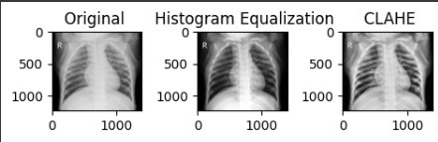
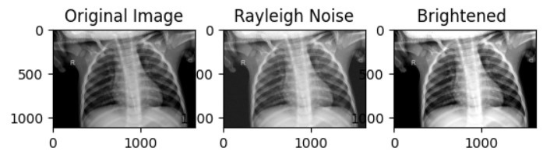
Add filters
Orignal image
Image after filter
The second stage
Add filters to the image

Slide 24
Takes the decision
The Third stage
Takes the decision
Norm﻿anl Cl﻿ass
Pneumo﻿n﻿﻿ia Cla﻿ss

Slide 25
Information about the
Ai model

Slide 26
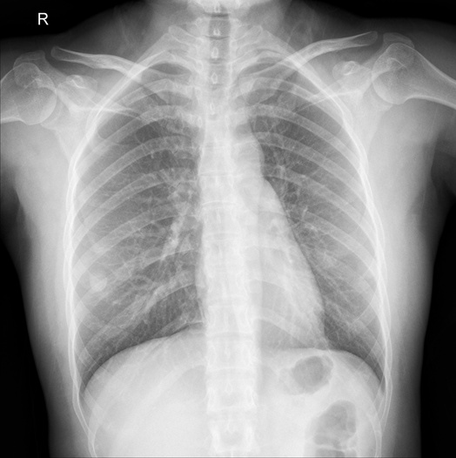
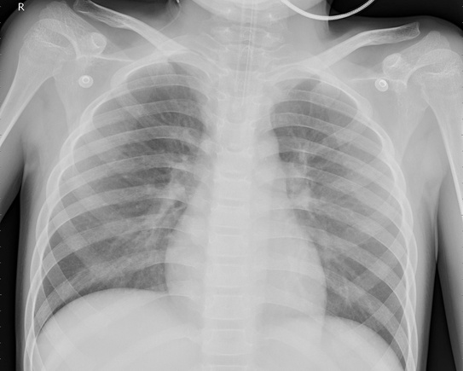
Information AI model
Number of images used to build the model
Total Images: 2600
Nor﻿mal: 1300
Pneum﻿o﻿n﻿ia: 1300
85% training
15% Testing
1105 Images
Imag﻿es from Kaggle Website
1105 Images
Chest X-Ray Images (Pneumonia)
195 Images
algorithom CNN
286K Downloads

Slide 27
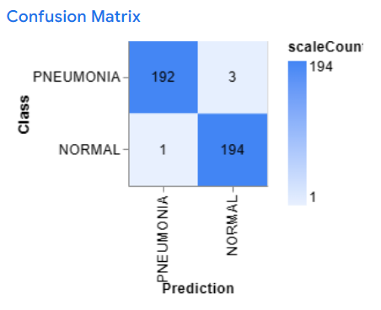
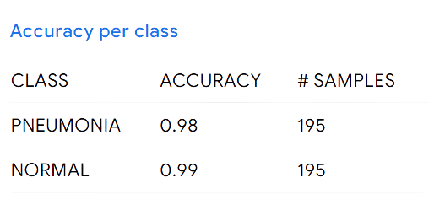
Information Ai model
accuracy = 98.5%
Epochs: 1000
Batch size: 16
Learning Rate: 0.003
accuracy = (number of correct predictions) / (number of total predictions)

Slide 28
Results

Slide 29

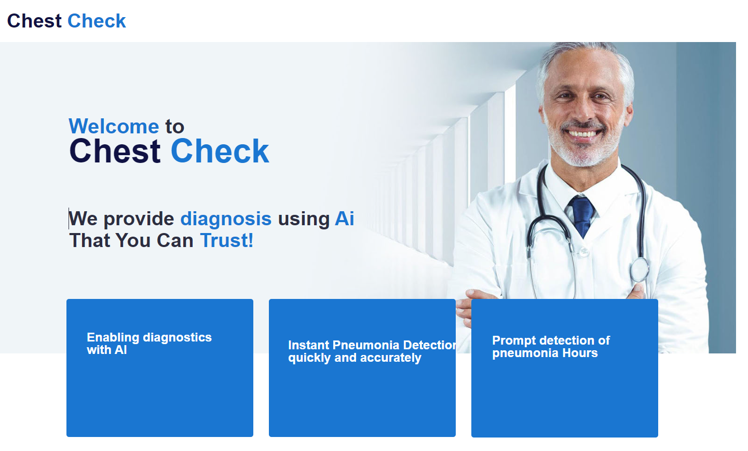

Slide 30
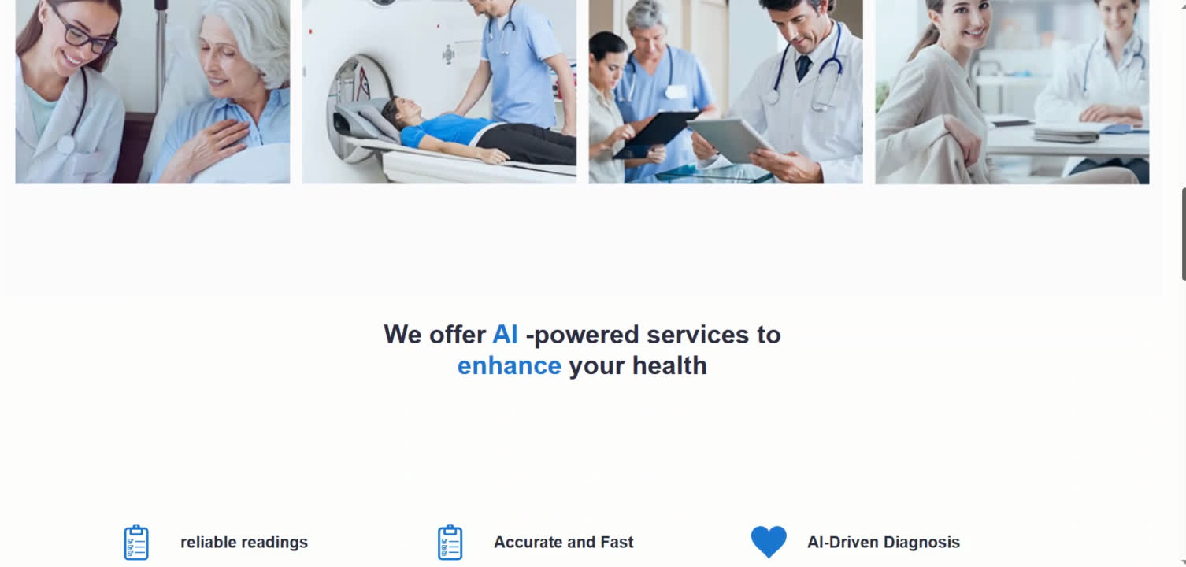

Slide 31
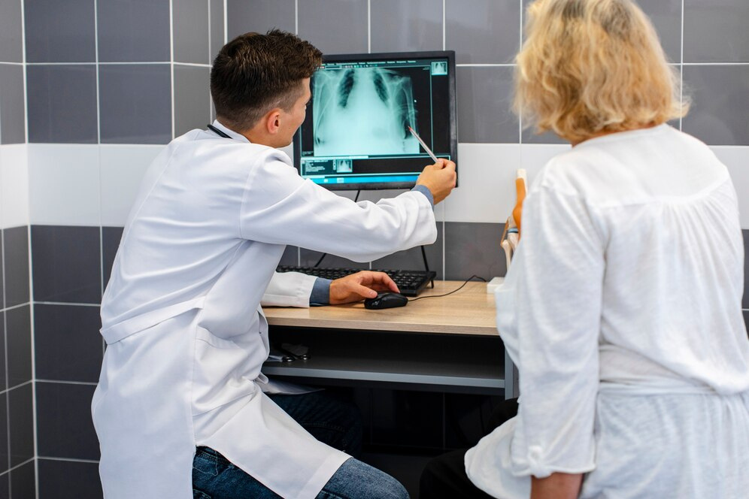
Future work
Chest X-ray machines
The AI model will tell the doctor the result

Slide 32














Technology and tools use﻿d
Figma

Slide 33


Thanks

